Slide 1
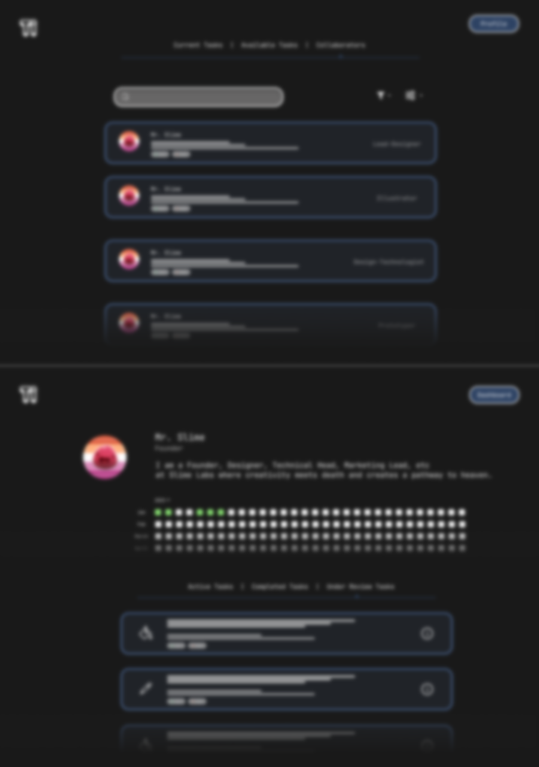
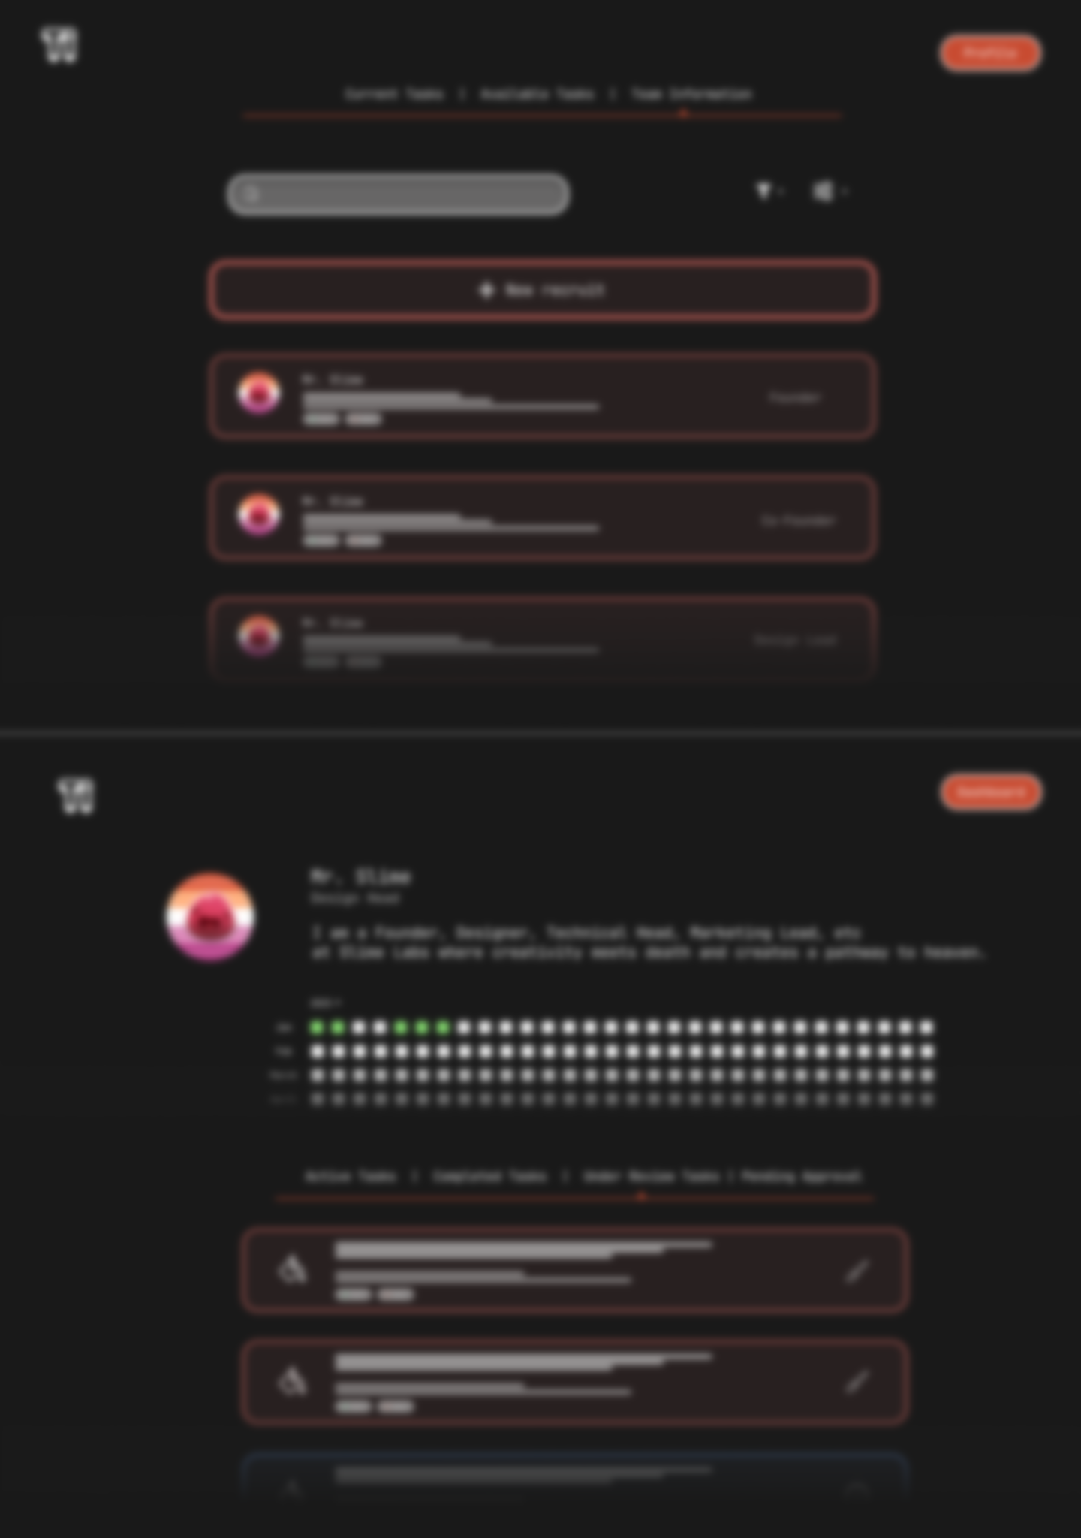
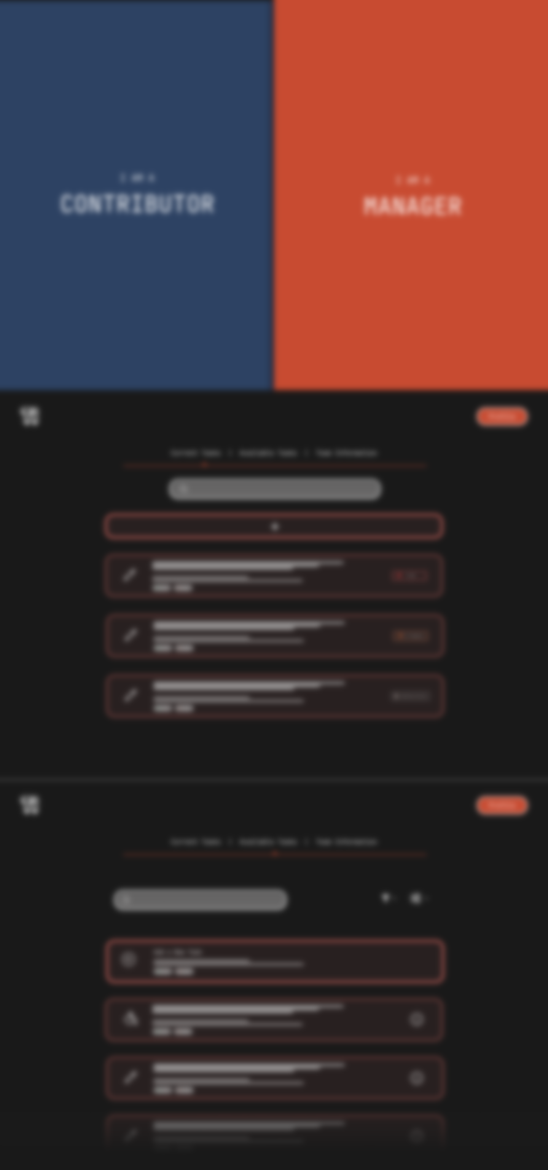
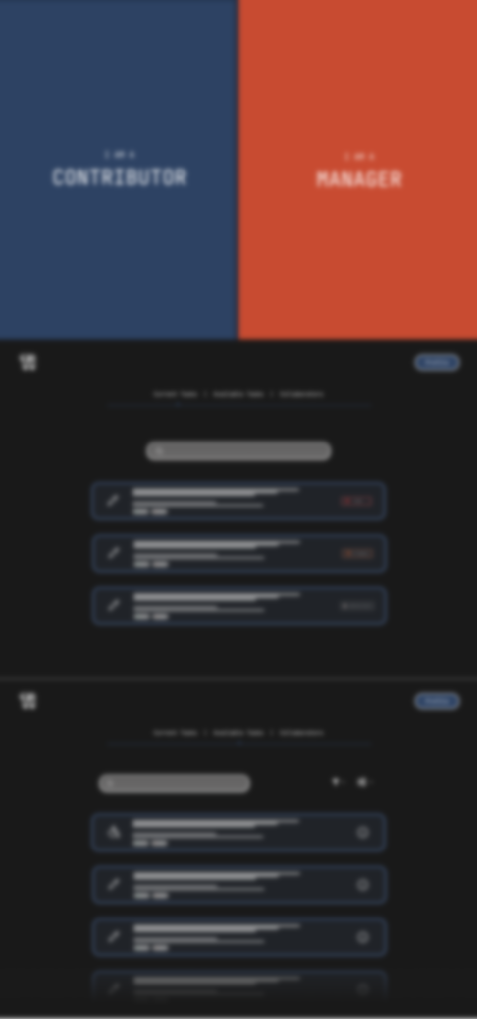
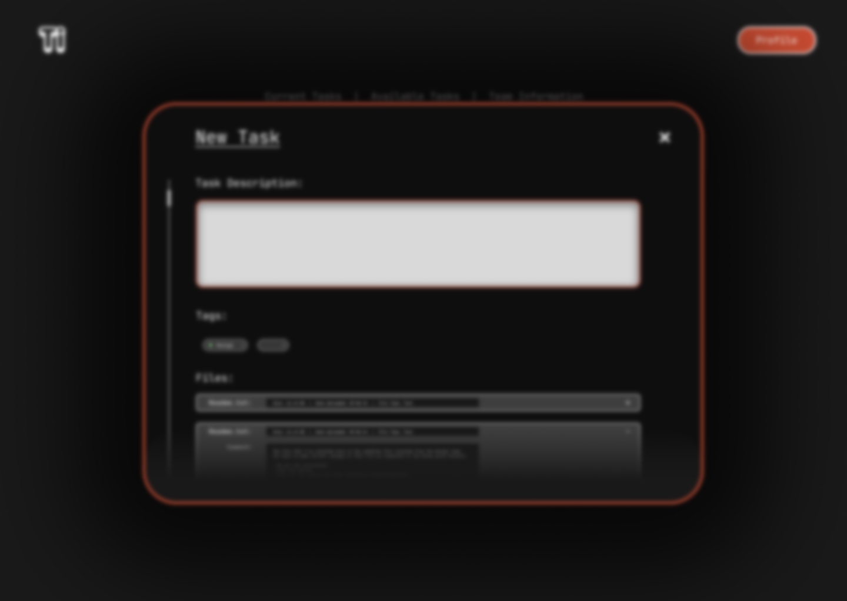
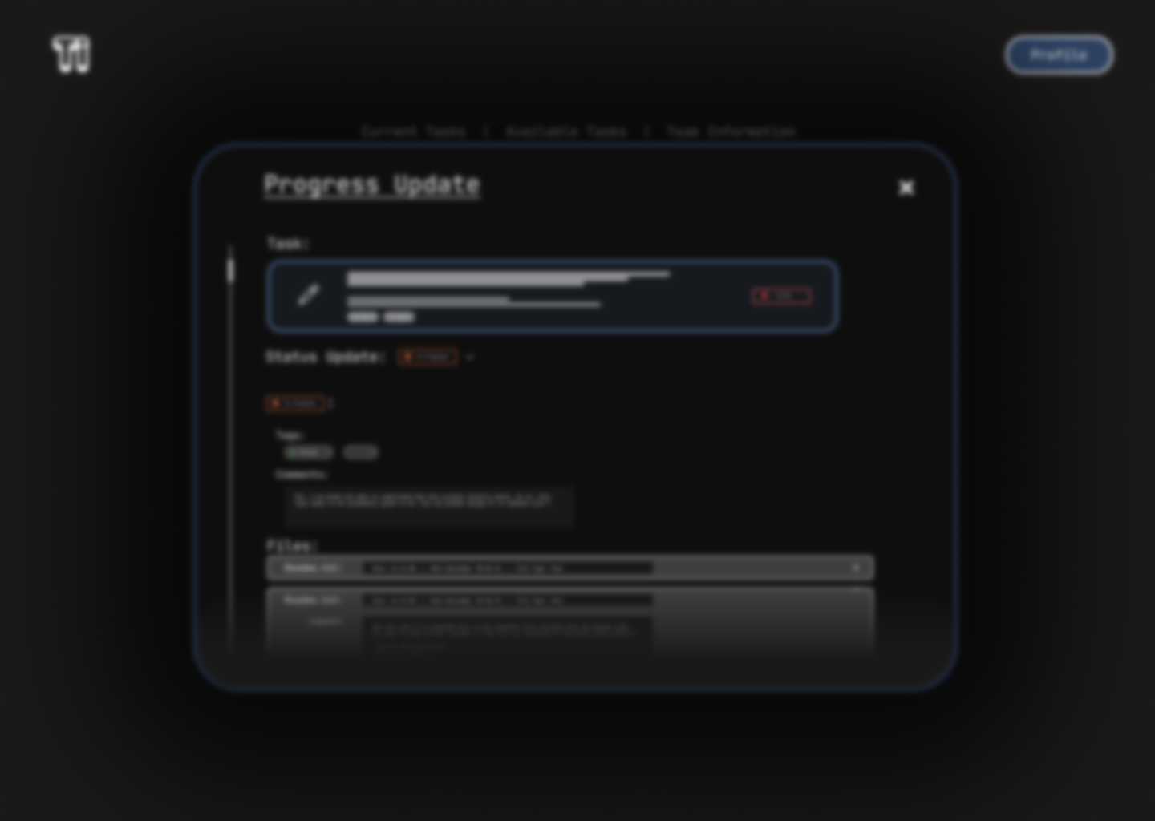


TaskIt

Slide 2


Know Us a Bit ?
Priyanshu Nandan,
Designer,
Delhi Technological
University,
Linkedin
Mohammad Bashar,
Web3 Developer,
Delhi Technological
University,
Linkedin

Slide 3
What are we making ?
“We are building a Web Application that will simplify the task management in teams and the current way of freelancing. And provide a more secure and reliable way to finish and share tasks in a user friendly way.”

Slide 4
Why are we making ?
1. ”Lack of Secure and Efficient File Sharing & Payment System”.
2. “Inefficient Communication and Collaboration”.
3. “Difficulty in Managing Remote Teams”.
4. “Scalability Issues in Task Management”.
5. “Lack of mutual profit for freelancers and clients alike”.
6. “Difficulty in Tracking Progress and Deadlines”.
And Many More.....

Slide 5
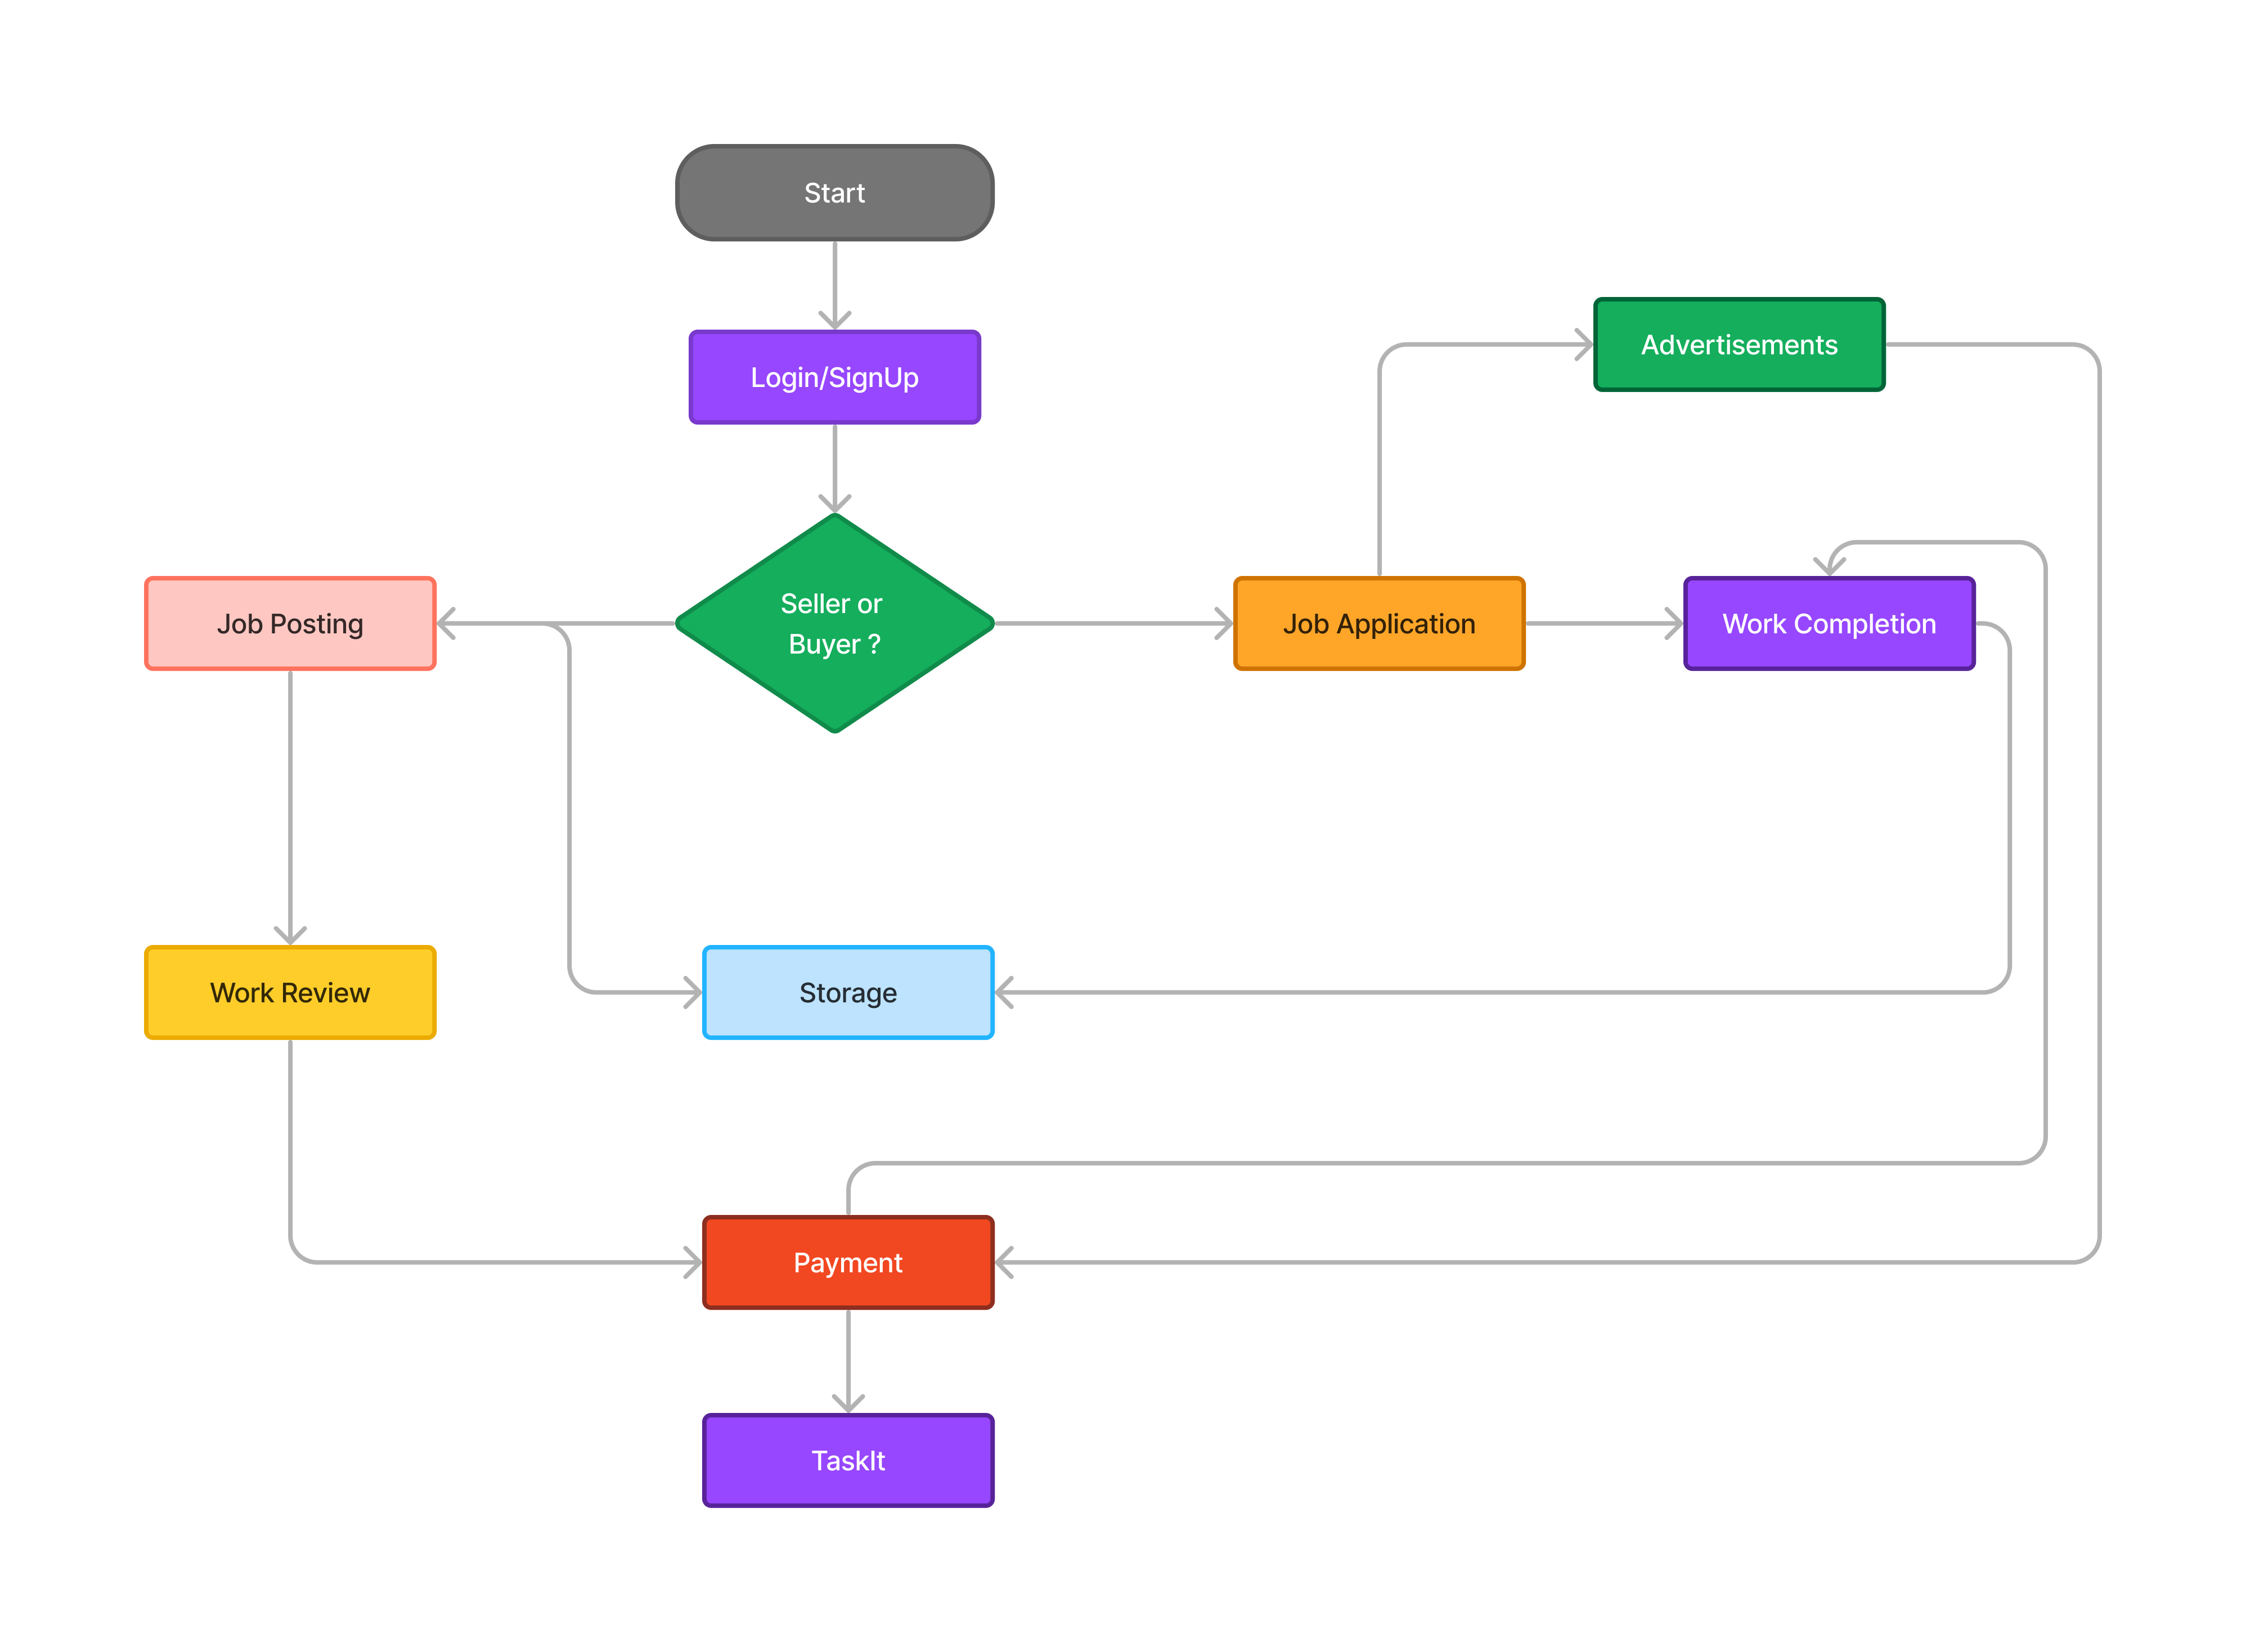
How does it solve the Problem ?

Slide 6
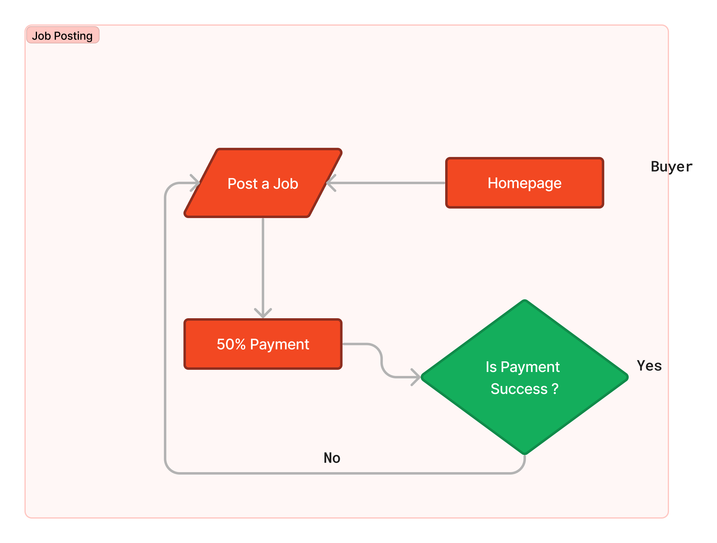
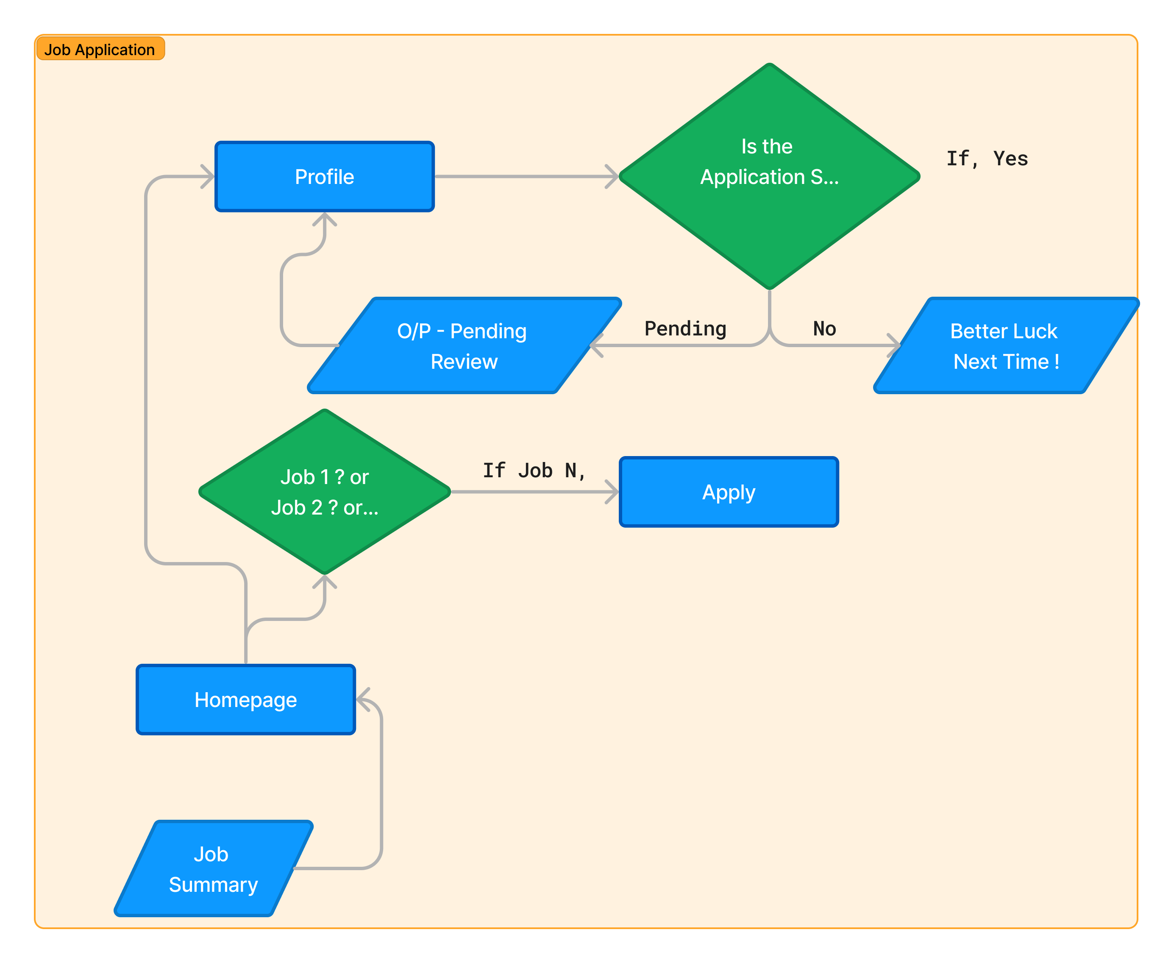
Job Posting and Application:

Slide 7
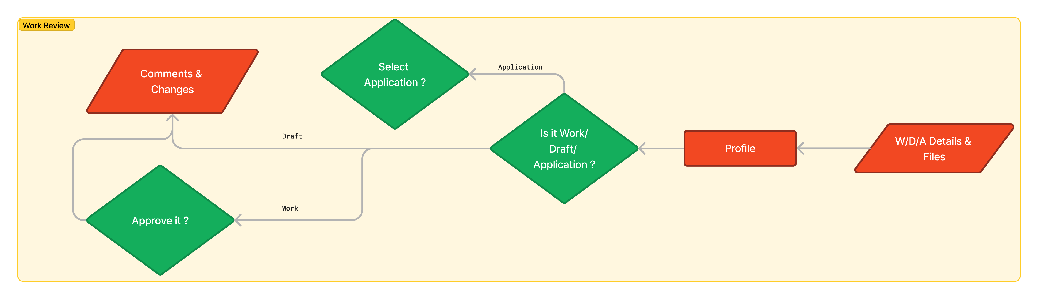
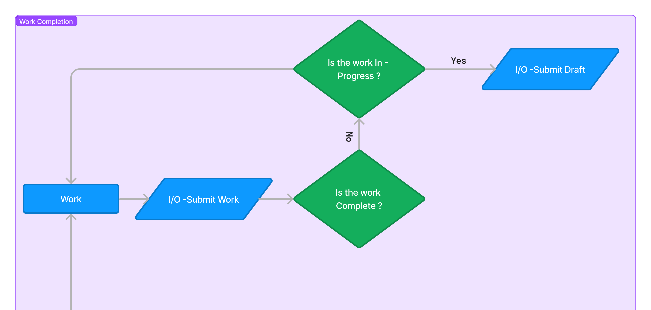
Work Review & Completion:

Slide 8
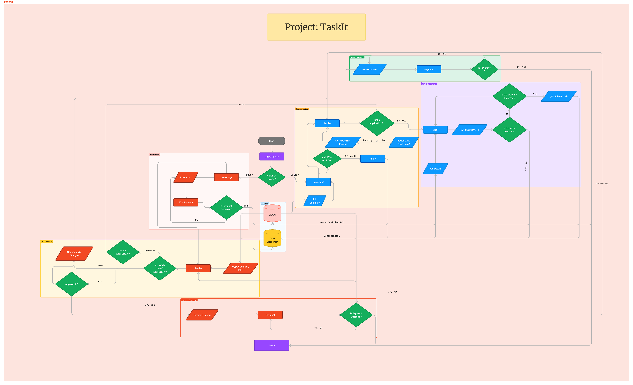

Slide 9
Who will use ?
1. ”Freelancers”.
2. “Education & E-Learning Platforms”.
3. “Smaller and Larger Teams”.
4. “Remote and Distributed Teams”.
5. “Creative Professionals & Agencies”.
6. “Software Development Teams”.
And Many Many More.....

Slide 10

Why Blockchain ?
1. ”Security Enhancement”.
2. “Transparency and Accountability”.
3. “Decentralization”.
4. “Data Integrity and Trust”.
5. “Automated Smart Contracts”.
6. “Enhanced Data Privacy”.

Slide 11

UI/UX Design:

Slide 12
Technical Architecture
FrontEnd
Backend
Security
Comm. & Notif.
Deployment
HTML/CSS/JS
Redux
PHP
MySQL
TON Storage
JWT
OAuth2
SSL/TLS
Web Socket
Telegram
Docker
Kubernetes
CI/CD Pipelines
Cloud Providers
"Success is the sum of small efforts, repeated day in and day out."
– Robert Collier

Slide 13
Sources of Revenue
Subscription Fees for $0 Jobs Posting.
Royalties Charged on successful completion of a Job.
Charges for API Access.
Marketplace for Add-Ons.
Advertisements.
... And Many More !!!

Slide 14
Roadmap for the next 1-year
First 3 Months
First 6 Months
First Year
Future
Advertisements
Collaborations
Trial Periods
Fully Customizable Pricing Structure
(Free, Teams, Corporate)
Periodic Updates
Introduction
Of
Task Management System
Reward Systems,
3rd Party Add-Ons Support, Community & MarketPlace Launch, API Selling, etc.

Slide 15
Target MAU & DAU (in 1 Year):
Considering the conservative target market size of 100,000 business users,
Target MAU after next 1 year - Approx. 12,000 Users
Target DAU after next 1 year - Approx. 2,400 Users
Onboarding Plan:
SUBSCRIPTION
MONEY
UI/UX
COMMUNITY & ADD-ON SUPPORT
Freemium Model
(Free for basic use
&
Paid for enhanced Security)
Low Royalty fees
&
Protection against frauds
Super Easy to navigate UI/UX Design.
Work environment customizations & Added Features through Add-Ons.
They can reach out to the community or TaskIt forums for help or interacting with the entire team.

Slide 16
TaskIt

